Slide 1

PCA on MNIST - Let’s trace shape of nodes

Slide 2
Reference
Youtube
Code

Slide 3
Worm Up

Slide 4
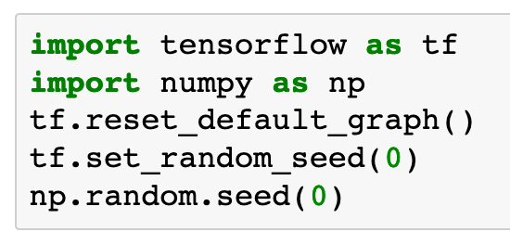

Slide 5
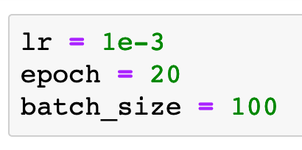

Slide 6
Data

Slide 7
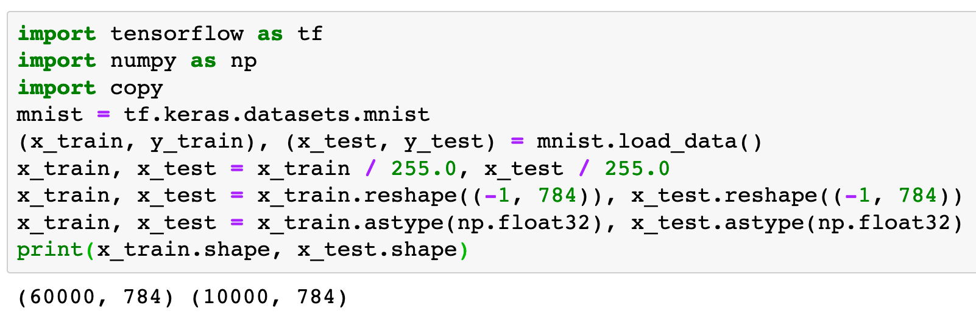

Slide 8
Graph

Slide 9
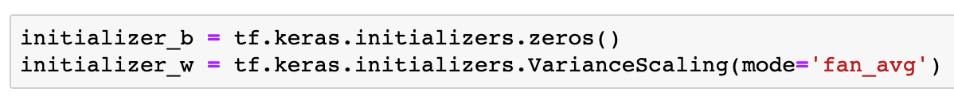

Slide 10
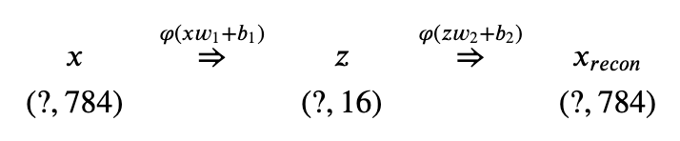

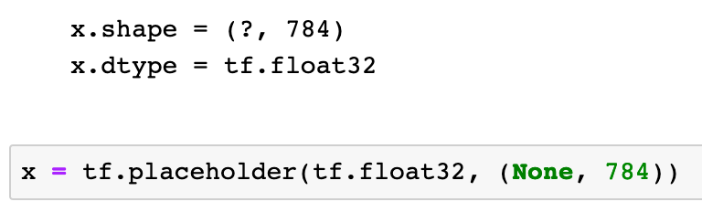

Slide 11
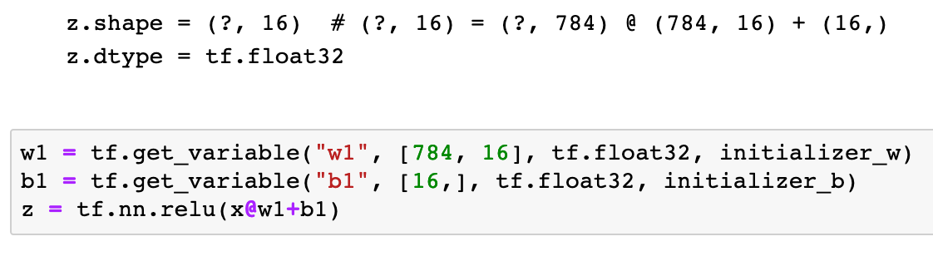

Slide 12
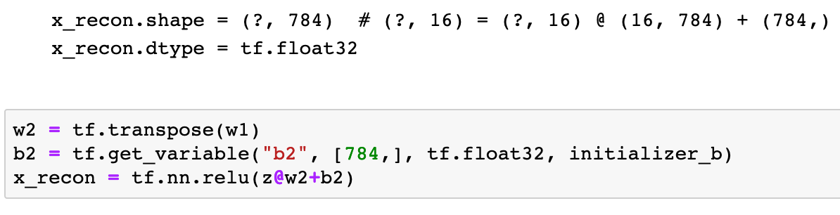

Slide 13
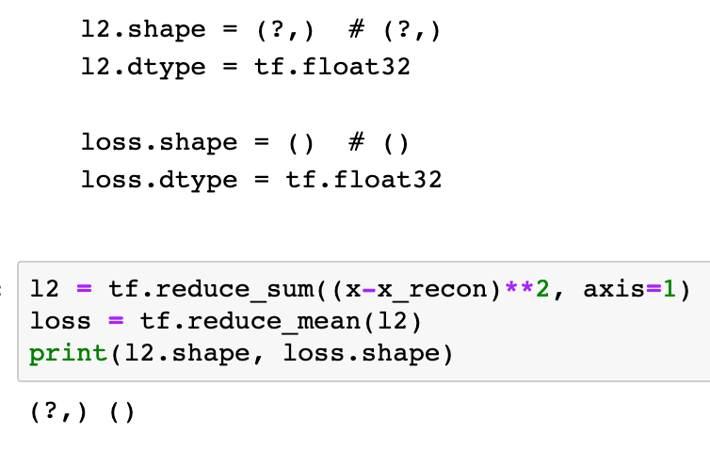

Slide 15
Session

Slide 16
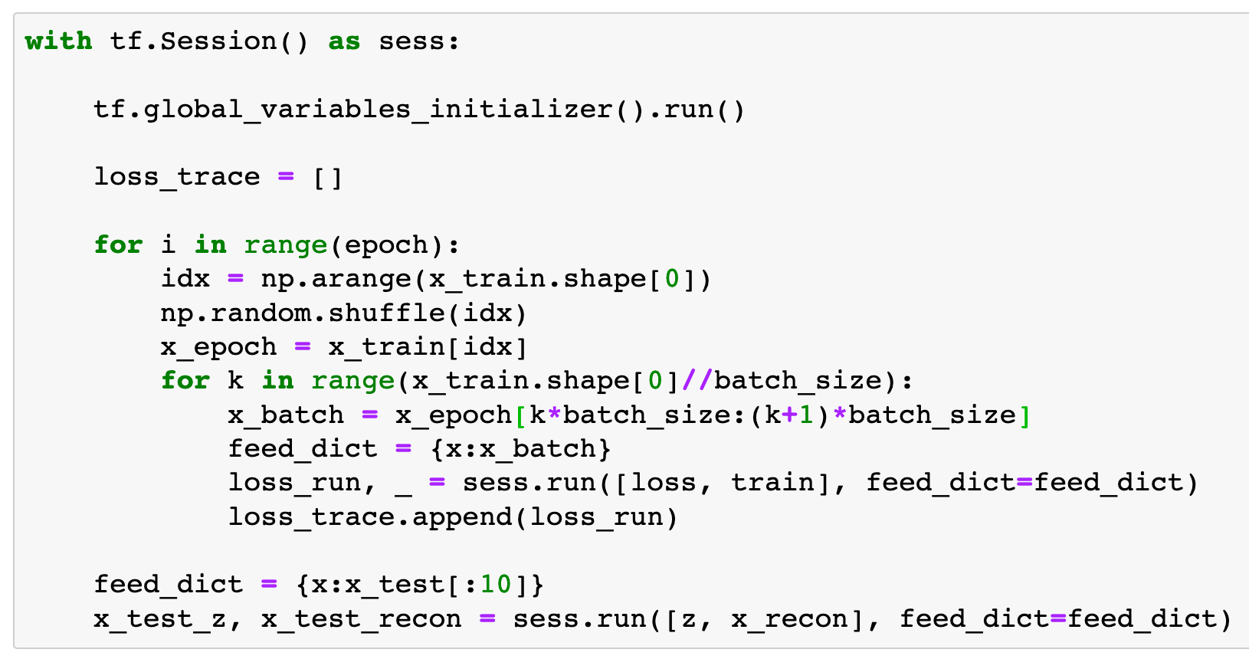

Slide 17
Report Result

Slide 18
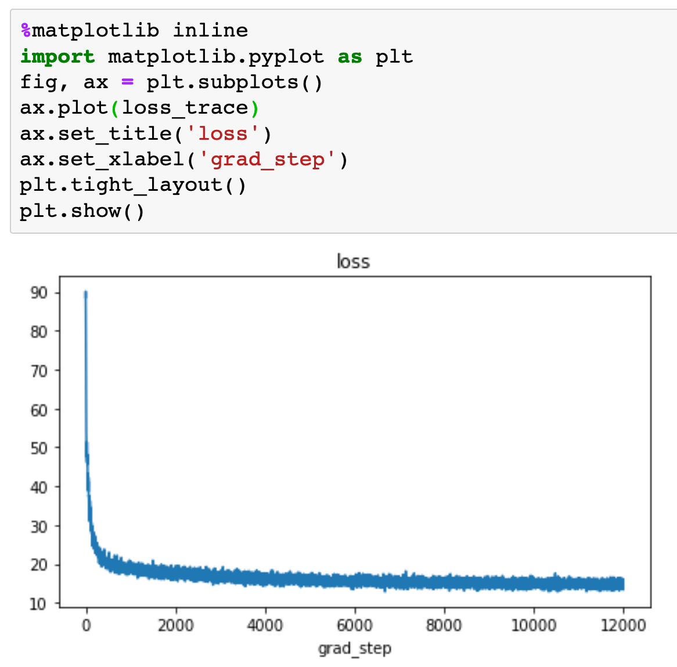

Slide 19
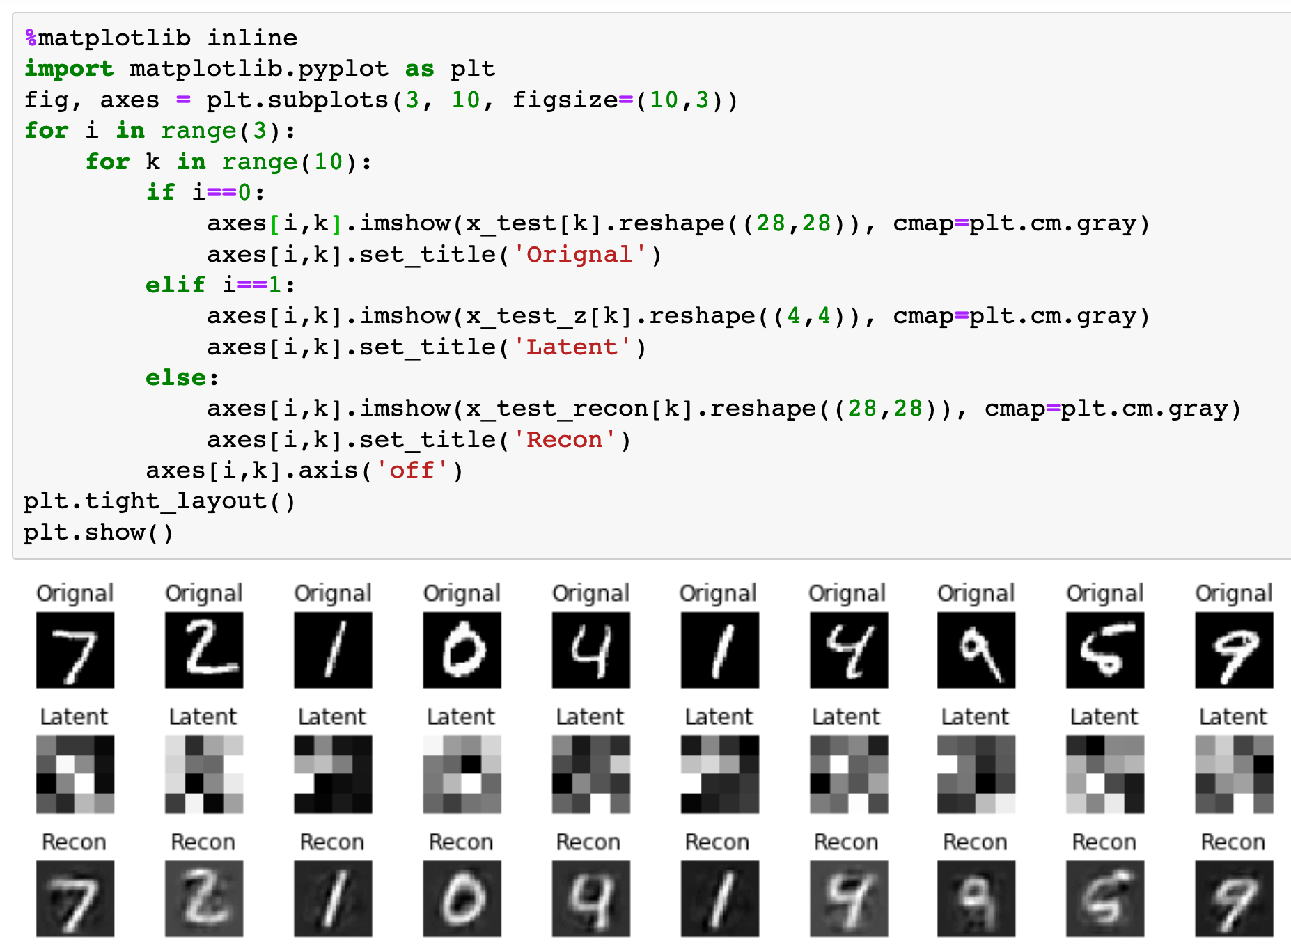

Slide 20
Now
Let’s Play with Code

